Slide 1
Gestures and Movement
College Comm

Slide 2
Eye Contact
Look around the audience
Don’t stare at your notecards
Don’t stare at one person
Don’t look above heads

Slide 3
Distractive Gestures
Be aware that nervousness or feelings of inadequacy can show immediately in your gestures. These can be very distractive and misinterpreted.
For example:
Hands on hips = condescending, parental, overbearing
Crossed arms = cutting off, disagreeing, wanting to protect
Hands crossed in front = feeling weak, timid, needing protection.
Hands joined behind your back = you’re on parade!
Hands in pockets = nervousness. This can result in jingling any change or keys, making it even more obvious you don’t know what to do with your hands!

Slide 4
Symbolic Gestures
Communicate words, numbers, position.
For example:
A raised hand signals for a stop
A thumbs-up showing you agree
Three fingers for the number three
Pointing to show a position – up, down, behind, beside

Slide 5
Descriptive Gestures
Communicate an idea or movement.
For example:
Spreading hands apart to show length
Swaying hands to show flow of movement
Using hands to show a shape

Slide 6
Emotional Gestures
Suggest feelings.
For example:
Hands clasped to show pleading.
Clenched fist to show anger or hostility
Using a pointed finger. This makes you look accusatory, even if that wasn't your intent.
Tips of fingers together shows power
Hands apart with palms facing audience – power
Hand to chest

Slide 7
Be Spontaneous
The Most Effective Gestures Are Spontaneous.
These gestures are purposeful. They are the outward expression of your inner thoughts and feelings.
Use gestures with purpose in public speaking situations and you will engage your audience, and help them comprehend and remember your message.

Slide 8
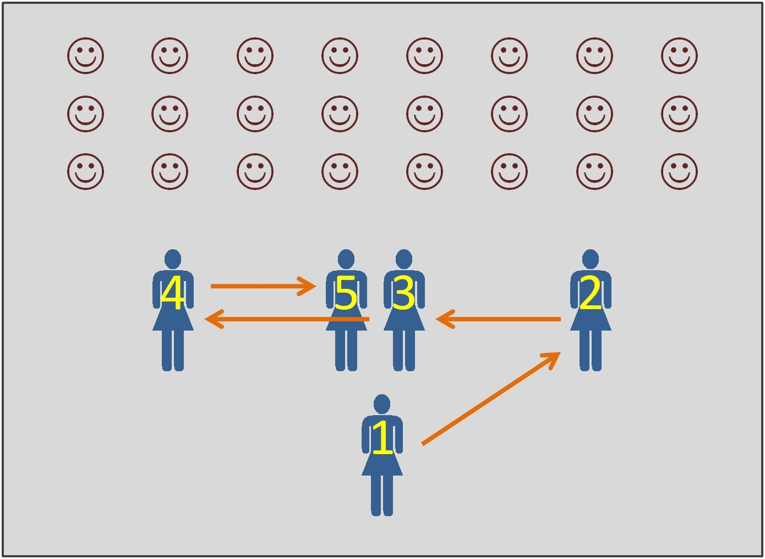
Notes:
http://www.ratespeeches.com/a=speech-walking-and-movement-patterns

Slide 9
Position 1: Introduction
Walk briskly to the position 1 where you will deliver the introduction. Stand in the center of the speaking area. You should be closer to the back of the speaking area, not too close to the audience, but not all the way to the wall.
Position 2: Main Point 1
Move right and forward gracefully to position 2 where you will deliver the first main point. Stand in the right front of the speaking area, closer to the audience than in the previous position.
Position 3: Main Point 2
Move left gracefully to position 3 where you will deliver the second main point. Stand in the center front of the speaking area, close to the audience as in the previous position.
Position 4: Main Point 3
Move left gracefully to position 4 where you will deliver the third main point. Stand in the left front of the speaking area, close to the audience as in the previous position.
Position 5: Conclusion
Move right gracefully to position 5 where you will deliver the conclusion. Stand in the center front of the speaking area, similar to position 3.

Slide 10
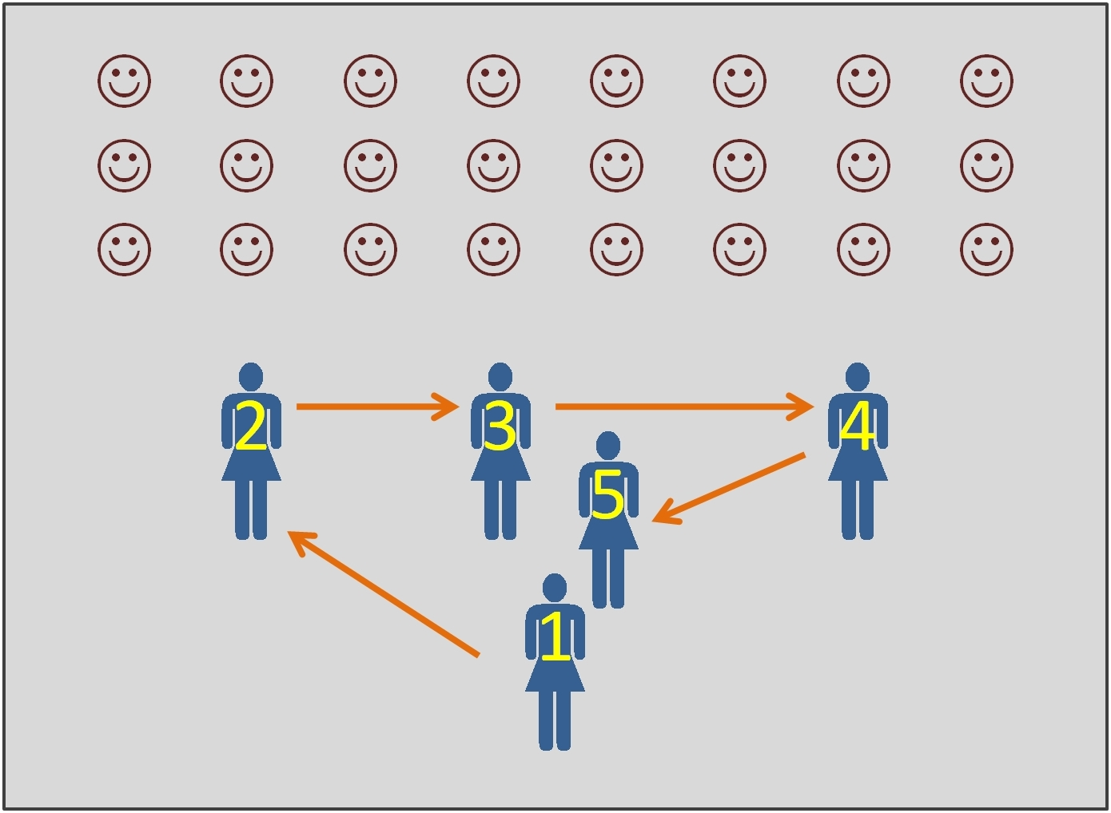

Slide 11
