Slide 1
Claims
and
Counterclaims

Slide 2
Elements of argument
Intro: Claim
- 2 to 3 Body paragraphs with Reasons – Evidence
Counterclaim (Turn Against)
Recognize other side using specific language, which is called a concession
- Reasons - Evidence
- Refute (Turn Back): Return to original argument using specific language and use evidence
Conclusion: Call to Action

Slide 3
A thesis is…
A position you take on a subject and what you believe and intend to prove in your essay
Answers the prompt
Includes the “why”
Prompt: Does America need more college graduates?
Example: American needs more college graduates to help the future of the country.
Bad: College is good.

Slide 4
A claim is…
Supports your thesis – is not the same as your thesis
Reasons that prove your thesis
Thesis: American needs more college graduates to help the future of the country.
Claim: More college graduates will help the economy.

Slide 5
A counterclaim is…
any position against your thesis
Prompt: What kind of character is Eddie and why?
Bad: Some disagree that Eddie is a flat character.
Good: Despite Soto’s protagonist Eddie being a flat character, some may think he makes several key decisions which would otherwise indicate that he is, in fact, complex.
Use the correct language to form your counterclaim
Although ________, some may think _______.
Despite _______, in reality _______.

Slide 6
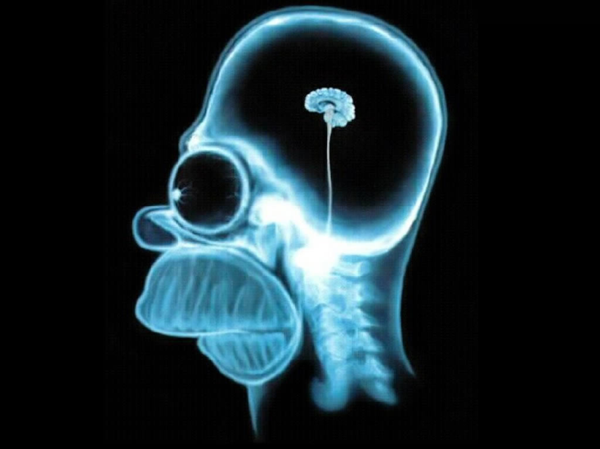
Counterclaims are beneficial!
They acknowledge your reader’s intelligence
They enhances your credibility
They sharpen & clarify your thesis (main claim)
They provide a new way to argue your position
vs.

Slide 7
Ways to Establish Counterclaims
Show others’ views to be faulty!
Faulty Factual Assumption
Faulty Analytical Assumption
Faulty Values
True but Irrelevant
This makes YOUR argument
stronger!

Slide 8
Sample Thesis:
Thesis:
Students in high school need to study the causes of racism.

Slide 9
1. Faulty Factual Assumption
Racism is a thing of the past; therefore, students don’t need to study it.
The factual assumption in this example is that racism is a thing of the past.
Show that racism continues to be a problem.
And/or…show that students must understand the past as well as the present to function adequately in civil society.

Slide 10
2. Faulty Analytical Assumption
Learning about racism might make students more racist.
The analytical assumption is that learning about racism can make you racist.
Show that the cause(s) of a problem is not the same as causing or creating the problem.

Slide 11
3. Faulty Values
It does not matter that students are racist.
The faulty value is that it does not matter if students are racist.
Show that it DOES matter!

Slide 12
4. True but Irrelevant
Students are already familiar with racism; they don’t need to study it in school.
Acknowledge that while many students are, in fact, already familiar with racism, they still need to learn what causes it.

Slide 13
5. YOUR argument gets stronger!
Previous generations didn’t study the
causes of racism, so students now don’t need to.
Show that previous generations did not function adequately in civil society because they had problems with racism.
Therefore, the fact that they didn’t learn about the causes of racism, together with this other information, actually supports the claim that students do need to learn what causes racism.

Slide 14
Structure of a Body Paragraph
Topic Sentence (1 sentence)
Embed evidence:
Give context
Integrate quotations
Commentary/analysis
Transition
Embed evidence – There is no specific amount you need, but you need to transition between each piece
Concluding Sentence/Transition (1 sentence – connects back to your topic sentence)

Slide 15
Providing Context
Context: Provide information about the source to set up the quotation.
Make sure it helps introduce your quotation.
Context: Statistics say going to college will decrease a person’s unemployment rate.
Quotation: The Bureau of Labor Statistics states, “As level of education increases, the earnings rise and unemployment rates fall” (“New School Year, Old Story: Education Pays).

Slide 16
Outline
Topic Sentence: A person will make more money in his/her life by going to college.
Context: Statistics say going to college will decrease the chance of unemployment.
Quotation: The Bureau of Labor Statistics states, “As level of education increases, the earnings rise and unemployment rates fall” (“New School Year, Old Story: Education Pays).

Slide 17
Counterclaim Paragraph
State the concession
Turn against
Explain the counterclaim
Give evidence
Provide the warrant (elaboration/ analysis)
Turn back/refute
Explain the evidence AGAINST the counterclaim
Give evidence
Provide the warrant (elaboration/ analysis)
Conclude paragraph

Slide 18
Counterclaim
Concession (Counters Thesis)
1
2
Give context/background (1-2 sentences)
3
Integrated Quotation from Text
Draw Inferences
Connect to Topic Sentence
Analyze Quotation (2-3)
4
Turn Back/Refute; Explain (2 sentences)
5
6
Integrated Quotation
7
Analysis
Concluding Sentence (Bring together what you found out)
8

Slide 19
State Concession – Turn Against
Introduce the counterargument. Use correct language:
Although ________, some may think _______.
Despite _______, in reality _______.
Some people say ____ while others say _____.

Slide 20
Turn Back/Refute
Now that you have examined the counterargument, return to your original argument.
Use correct language:
Transition + why the counter is wrong
However, reason why counter wrong
Although, reason why counter wrong

Slide 21
Claim: Pepsi is better than Coke
Reasons: Has a sweeter taste and Pepsi owns more products.
Counterclaim: Although Pepsi is a great product, Coke has a better market cap.
Refute: However, Pepsi has more flavors than Coca-Cola.

Slide 22
Turn Back/Refute Example
Prompt: Write an intro and 2 body paragraphs supporting a claim that we either need or do not need more college graduates.
Thesis: America needs more college graduates.
Claim #1: People with degrees can better serve the economy by being employed. Quote to support: “…the unemployment rate for workers with a professional degree was also the lowest of any education level” (New School Year 63).
Concession: Although Obama stresses the importance of college, some can be successful without it. Quote to support: “Liddell, whose $1 million purses have bought him a mansion and a Ferrari” (O’Connor 41).
Turn Back/Refute: However, most careers helping the public require higher education.
Quote to support: “You want to be a doctor…teacher…police officer…you’re going to need a good education” (Obama 68).

Slide 23
Turn Back/Refute Example
Prompt: Write an intro and 2 body paragraphs supporting a claim that we either need or do not need more college graduates.
Thesis: America needs more college graduates.
Claim #1: People will let the future of the country down by not being a college graduate. Quote to support: “…develop your talents and your skills and your intellect so you can help us old folks solve our most difficult problems” (Obama 68).
Concession: Even though college is important, some people obtain careers not using their degree. Quote to support: “…nearly 80% of Ultimate Fighters have at least some college education, if not degrees” (O’Connor 41).
Turn Back/Refute: Although, it is rare to find that kind of success that helps society.
Quote to support: “…sometimes you get that sense from TV that you can be rich and successful without any hard work…Chances are you’re not going to be any one of those things” (Obama 70).

Slide 24
State Concession
Introduce the counterargument. Use correct language:
Although ________, some may think _______.
Despite _______, in reality _______.
Some people say ____ while others say _____.

Slide 25
Citation
(Author page #)
(Article title page #)

