Slide 1
Embedding Textual Evidence
By Julie Faulkner

Slide 2
Essential Questions
What are some ways to embed quotes purposefully and impressively?
What punctuation marks are necessary for properly embedding quotes?
Why embed quotations?
© Julie Faulkner

Slide 3
Punctuation Marks Review Human Matching Game
Quote Marks “”
Semi-Colon ;
Colon :
Periods .
Commas ,
Brackets []
Ellipses …
Em Dash --
Parenthesis ()
© Julie Faulkner

Slide 4
Video Review Recap
“Strange Punctuation Marks”
https://www.youtube.com/watch?v=ggnlmp3Zk14
© Julie Faulkner

Slide 5
Why embed quotations?
Properly embedded quotations are necessary to accurately reflect the content being cited and build the author’s credibility.
Properly embedding quotations also prevents inadvertent plagiarism.
Consider helium balloons. We all know what happens when you let go of a helium balloon: It flies away. In a way, the same thing happens when you present a quotation that is standing all by itself in your writing, a quotation that is not "held down" by one of your own sentences. The quotation will seem disconnected from your own thoughts and from the flow of your sentences.
© Julie Faulkner

Slide 6
Methods of Quotation Integration
Partial Quotation
Paraphrase
3. Message
4. Dialogue Tag
© Julie Faulkner

Slide 7
Methods of Quotation Integration
1. Partial Quotations
Incorporate a quotation into a sentence that you have already begun.
Example:
Realizing how hurt Piggy is, Ralph can’t decide “…between the two courses of apology or further insult” (Golding 222).
Note punctuation.
© Julie Faulkner
Notes:
(most impressive; demonstrates you are a sophisticated writer; most difficult to master)

Slide 8
Methods of Quotation Integration
2. Paraphrase
The statement must be in your own words. Add a citation—even if a paraphrase is in your own words, it is still someone else's idea.
Example:
At the conclusion of Lord of the Flies, Ralph realizes the horror of their actions: The tears began to flow and sobs shook him (Golding 222).
© Julie Faulkner
Notes:
(perfectly acceptable, just not as impressive)

Slide 9
Methods of Quotation Integration
3. Message
With a colon :
Introduce the quotation (complete sentence) with a complete sentence and a colon. What you cite should be follow-up or exemplary information about what you previously stated.
Example:
Ralph’s common sense is evident in the novel: “If a ship comes near the island they may not notice us. So we must make a fire” (Golding 222).
Note punctuation.
Imagine if the colon silently said, “For example.”
© Julie Faulkner
Notes:
(perfectly acceptable)

Slide 10
Methods of Quotation Integration
4. Dialogue Tag
With a signal phrase.
Introduce or end the quotation by identifying the speaker and/or text.
Example:
“Maybe there is a beast...maybe it's only us,” Simon cautions (Golding 222).
© Julie Faulkner
Notes:
(perfectly acceptable, just not as impressive)

Slide 11
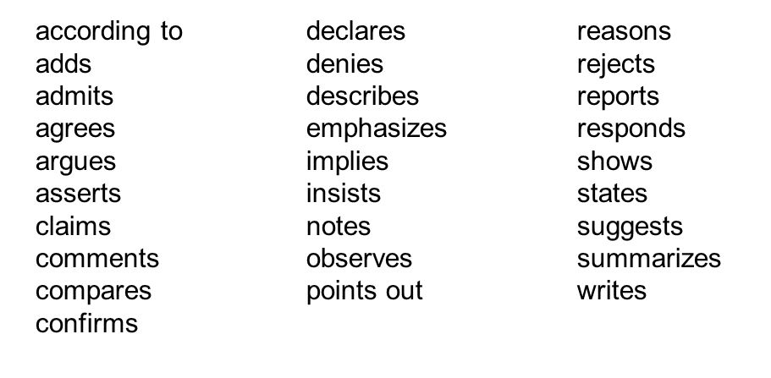
Methods of Quotation Integration
Signal Phrases
© Julie Faulkner
Notes:
(perfectly acceptable, just not as impressive)

Slide 12
Methods of Quotation Integration
Dialogue Tag Examples
In "Where I Lived, and What I Lived For,”
Thoreau states,
Thoreau asks,
According to Thoreau, a transcendentalist,
© Julie Faulkner
Notes:
(perfectly acceptable, just not as impressive)

Slide 13
Methods of Quotation Integration
Full Quotations
Block Quotation
For quotations that are more than four lines of prose or three lines of verse, place quotations in a free-standing block of text and omit quotation marks. Start the quotation on a new line, with the entire quote indented ½ inch from the left margin; maintain double-spacing.
© Julie Faulkner
Notes:
(perfectly acceptable, just not as impressive)

Slide 14
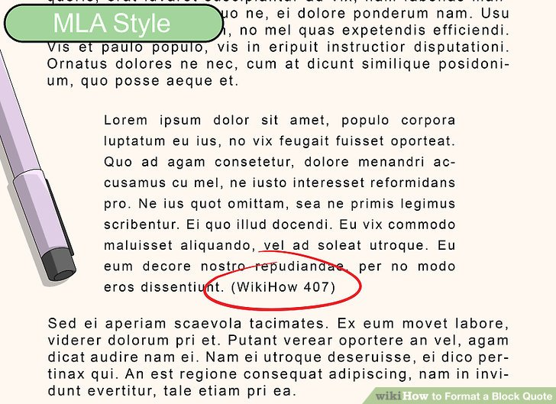
Methods of Quotation Integration
5. Full Quotes
Block Quotation Example
Note punctuation.
© Julie Faulkner
Notes:
(perfectly acceptable, just not as impressive)

Slide 15
Methods of Quotation Integration
While you do need to mix up your quotation integration, you need to also choose purposefully.
It matters which method you choose.
You shouldn't be able to “hear” your quotation marks.
© Julie Faulkner

Slide 16
Common Pitfalls
Fragments and run-ons
Inaccuracies of the source material
Referring to the quote directly
Ambiguities and vague integration
Point of view or verb shifts
Incorrect punctuation
Naked Quotations
© Julie Faulkner

Slide 17
Common Pitfalls
Fragments and run-ons
In the article that Eric Reid wrote titled “Why Colin Kaepernick and I Decided to Take a Knee,” he attempts to explain that their reasoning is not to disrespect the country, the flag, or the national anthem, but to bring awareness and protest police brutality to African Americans he says, “It baffles me that our protest is still being misconstrued as disrespectful to the country, flag, and military personnel. We chose it because it is exactly the opposite”(Reid).
© Julie Faulkner
Notes:
Encourage discussion on how to correct the error.

Slide 18
Common Pitfalls
Referring to the quotation directly
A piece of the text helps me by saying “symbolic actions such as wearing black armbands in school and draft-card burning fits into this category,”(First Amendment).
Also note incorrect comma usage.
© Julie Faulkner
Notes:
Encourage discussion on how to correct the error.

Slide 19
Common Pitfalls
Ambiguities
Ambiguous Pronouns: Make sure the name of the person who said the quote is not in an introductory phrase, but part of the subject. The subject of the sentence should use the name of the person who said the quote.
Incorrect: In Jane Smith’s book about pets, she claims that “people who own dogs have lower levels of stress.”
Correct: In her book about pets, Jane Smith claims that “people who own dogs have lower levels of stress.”
© Julie Faulkner
Notes:
Encourage discussion on how to correct the error.

Slide 20
Common Pitfalls
Vague integration – Don’t write this way!
One page X it states,
In paragraph 5, the author says,
In the story,
© Julie Faulkner
Notes:
Encourage discussion on how to correct the error(s).

Slide 21
Common Pitfalls
Point of view or verb shift errors
Original quotation: "Reading is also a process and it also changes you."
Correction: Margaret Atwood wants her readers to realize that "[r]eading is also a process, and it also changes [them]" (30).
Note punctuation.
© Julie Faulkner
Notes:
Encourage discussion on how to correct the error.

Slide 22
Common Pitfalls
Incorrect punctuation
Eric Reid spoke on behalf for Kaepernick, who was fired for taking a knee during the anthem, by stating: “I remember thinking our posture was like a flag flown at half-mast to mark a tragedy” (Reid).
© Julie Faulkner
Notes:
Encourage discussion on how to correct the error.

Slide 23
Common Pitfalls
Naked Quote
There is a big difference in how children learn because they haven’t been taught the correct level of reading skills. And that affects them later in life. “34 percent of children that enter kindergarten lack the basic language skills needed to learn how to read,” (Literacy Facts & Stats).
© Julie Faulkner
Notes:
Encourage discussion on how to correct the error(s).

Slide 24
Guided Practice #1
Perfection or Pitfall?
In the article Jane Smith writes, “Snails can sleep for three years without eating” (99).
© Julie Faulkner
Notes:
I pulled up a polleverywhere.com poll and let students live vote on the correct answer.

Slide 25
Guided Practice #2
Perfection or Pitfall?
In her book about pets, Jane Smith discusses the benefits of owning a dog: “Dog owners are less likely to suffer from depression and have lower levels of stress than people who do not own dogs” (99).
© Julie Faulkner
Notes:
I pulled up a polleverywhere.com poll and let students live vote on the correct answer.

Slide 26
Guided Practice #3
Perfection or Pitfall?
Jane Smith states that there are many good reasons to eat dark chocolate. “Dark chocolate contains many antioxidants,” (99).
© Julie Faulkner

Slide 27
Guided Practice #4
Perfection or Pitfall?
Jane Smith asserts that people should exercise often, “People should try to exercise for at least thirty minutes every day.”
© Julie Faulkner

Slide 28
Guided Practice #5
Perfection or Pitfall?
It is a surprising fact that “only 55% of all Americans know that the sun is a star” (Smith 99).
© Julie Faulkner

Slide 29
Independent Practice
Use the story, “Marigolds”
Choose one quotation to create a Dialogue Tag
Choose another quotation to integrate a different way (Paraphrase or Partial Quotation)
© Julie Faulkner

Slide 30
Group Practice
Show what you know with a #tweetstorm!
© Julie Faulkner

Slide 31
Video Review Recap
Choose wisely.
https://www.youtube.com/watch?v=uHMR2ZhP6vY
© Julie Faulkner

Slide 32
Reflection
Rank your answers to the statements below using the scale of 1-5 (5 is the strongest)
I believe these methods will help me embed my quotations purposefully and effectively.
I understand thoroughly each method.
I feel ready to embed quotes using these methods.
© Julie Faulkner

